Slide 1
Building Web Servers with Node.js HTTP Module

Slide 2
Summary
Why Node.js for Web Servers?
Introduction to HTTP Module
Creating an HTTP Server
Handling HTTP Requests
Sending HTTP Responses
Real-world Examples
Best Practices
Conclusion
BY Hamza GUERMAJ 09-21-2023

Slide 3
Why Node.js for Web Servers?
High performance and scalability.
Event-driven, non-blocking I/O.
Real-time applications (chat, gaming).
Active open-source community.

Slide 4
Introduction to HTTP Module
Node.js HTTP module for web server capabilities.
Part of Node.js core.
Easily create HTTP servers and clients.

Slide 5
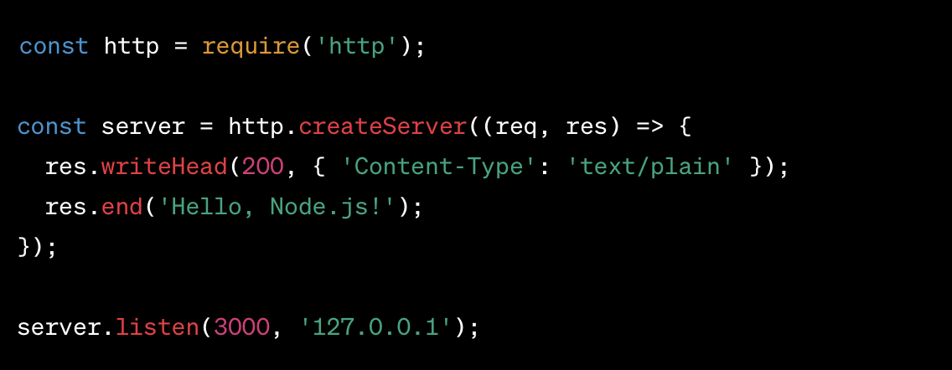
Creating an HTTP Server
“http.createServer( )”method.
Bind to a port and IP address.
Example: Basic HTTP server.

Slide 6
Handling HTTP Requests
Event-driven request handling.
Accessing request data and URLs.
Routing requests.
Example: Request handling.

Slide 7
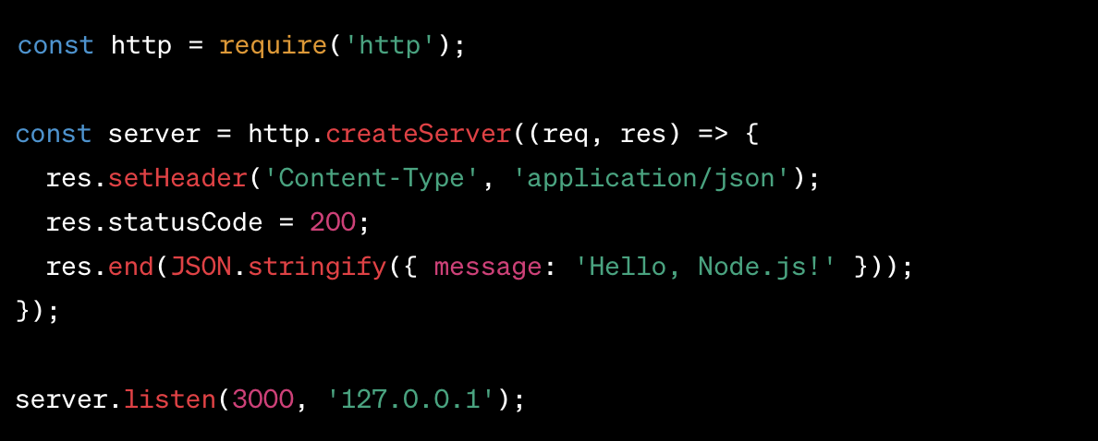
Sending HTTP Responses
Setting response headers.
Writing response content.
Handling status codes.
Example: Sending JSON response.

Slide 8
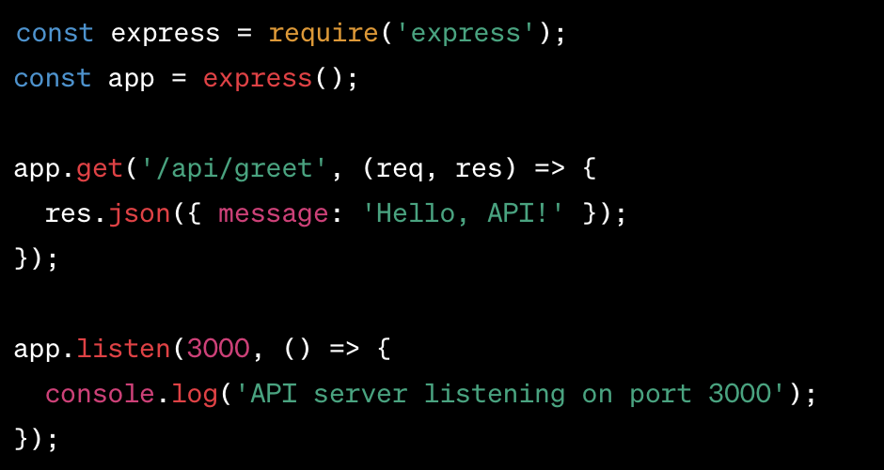
Real-world Examples
Building RESTful APIs.
Implementing Websockets.
Developing Microservices.
Example: Creating a RESTful API using Express.js.

Slide 9
Best Practices
To better use the NODE.JS HTTP MODULE:
Performance optimization.
Security considerations.
Scaling Node.js applications.
Input validation and sanitization

Slide 10
Conclusion
Node.js HTTP module simplifies web server development.
Ideal for real-time applications and APIs.
Node.js community offers support and tools.

Slide 11
Thank you.

